Slide 1

GPU: embedded CSE (eCSE)
Chris Johnson, Lorna Smith, EPCC
8th February 2024
https://www.archer2.ac.uk/ecse/calls/

Slide 2

Reusing this material
This work is licensed under a Creative Commons Attribution-NonCommercial-ShareAlike 4.0 International License.
https://creativecommons.org/licenses/by-nc-sa/4.0/
This means you are free to copy and redistribute the material and adapt and build on the material under the following terms: You must give appropriate credit, provide a link to the license and indicate if changes were made. If you adapt or build on the material you must distribute your work under the same license as the original.
Note that this presentation contains images owned by others. Please seek their permission before reusing these images.

Slide 3




Partners

Slide 4
Overview
What is the eCSE funding programme?
Who is eCSE funding for?
Programme logistics
Examples of eCSE work
Applying for a project – walk through
Summary
Questions

Slide 5
What is the eCSE funding programme?
The Embedded CSE (eCSE) programme funds software development for codes to run on GPU architectures
Allows software to be developed in a sustainable manner to improve research on GPU architectures
Facilitate efficient use of GPU resources through enhanced code performance/functionality
For developing software that facilitates research targeted at UKRI’s digital research infrastructure
e.g. future Exascale services, UK national AI services, national Tier-2 HPC services
Allows
employment of a Research Software Engineer (RSE) or PDRA
software development leading to research anywhere within the UKRI’s remit
Notes:
Idea originally started under the dCSE (HECToR) 2007

Slide 6
Who is eCSE funding for?
Two ways to be directly involved
As a Co-I / PI
e.g. a researcher who works with a code which runs (or potentially runs) on GPUs and requires an improvement
May not have the skills/availability to do the technical work
May/may not have expertise within own group
Someone else within group or elsewhere doing technical work
As a technical member of staff
RSE or PDRA has, or is gaining, software development expertise within HPC
PhD student with similar role coming to the end of studies
The panel will assess the teams ability to deliver on the project
e.g. staff skills, support from PI/Co-Is, training plan
Notes:
Idea originally started under the dCSE (HECToR) 2007

Slide 7
GPU eCSE Programme administration
Programme is administered by EPCC through ARCHER2, the UK National HPC Service
However, applications are not limited to projects targeting the GPU component of ARCHER2
Projects may utilise other GPU resources within the UK digital research infrastructure.
Successful applications can get access to the ARCHER2 GPU cluster – or should arrange suitable access to other GPU resources
Call is all about software development and not production runs
Other routes available to gain CPU time e.g. Access to HPC Calls

Slide 8
eCSE Programme Funding
Funding for can be requested for staff located at
institution of the PI
staff from the ARCHER2 centralised CSE support team
third party institution(s)
any combination of the above
A project funds 1 to 36 person months in total across all technical staff
Flexible: Effort can be spread over a longer period or employ multiple people simultaneously
Max duration 24 calendar months
Notes:
4 years = 576 PMs

Slide 9
eCSE Programme Funding (contd.)
We run a regular series of calls for proposals, with three calls per year
Support and encourage early career researchers
Many RSEs are early career
Good opportunity to develop software development skills – great for CV
Observers
Early career researchers invited to on-line panel meetings as observers
Usually have 3-4 observers at each panel meeting
Good opportunity to see what reviewers are looking for
Call open alongside GPU eCSE call – deadline 27th Feb
Proposals are selected by an independent diverse panel of experts

Slide 10
Example eCSE work
Transforming CPU code -> GPU code
Make improvements to existing GPU codes
portability to allow efficient running on wider range of architectures
performance
scalability
sustainability and maintainability
Implementing new algorithmics within code
Improvements to GPU-based software to allow new research
Adding new functionalities to existing GPU-based software
Enhancing existing GPU software for use in new research areas/workflows

Slide 11
Applying for an eCSE Project

Slide 12
Steps for applying to eCSE call
First steps
Start proposal in SAFE
Invite other team members
Start getting costing information
Costing not needed for ARCHER2 CSE team (we can get these internally)
Check financial arrangements
in particular if RSE not at institution of PI or part of ARCHER2 CSE team then money is paid to PI’s institution who must arrange to pass this on
Look through proposal forms to fill in (both on-line form and Word document)
Check through Terms document with your department
Read the guidance document!
Start requesting letters of support (optional)
Next steps
Complete main proposal form
Complete the on-line form – linking in completed proposal form, costing docs, CVs, letter(s) of support, etc.
On-line form must then be completed with
All project members having accepted invitation
All relevant documents attached
Submitted by 16:00 19th March 2024

Slide 13
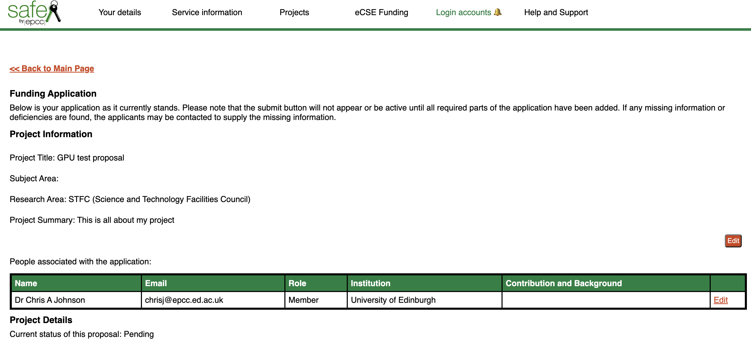
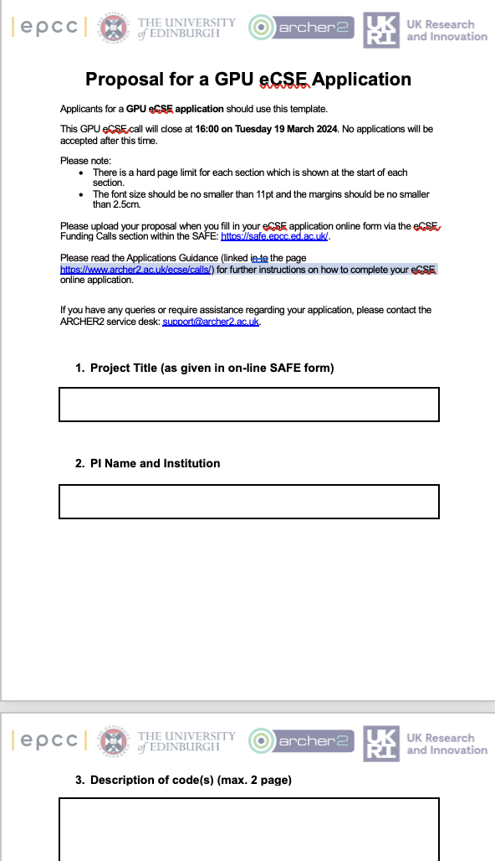
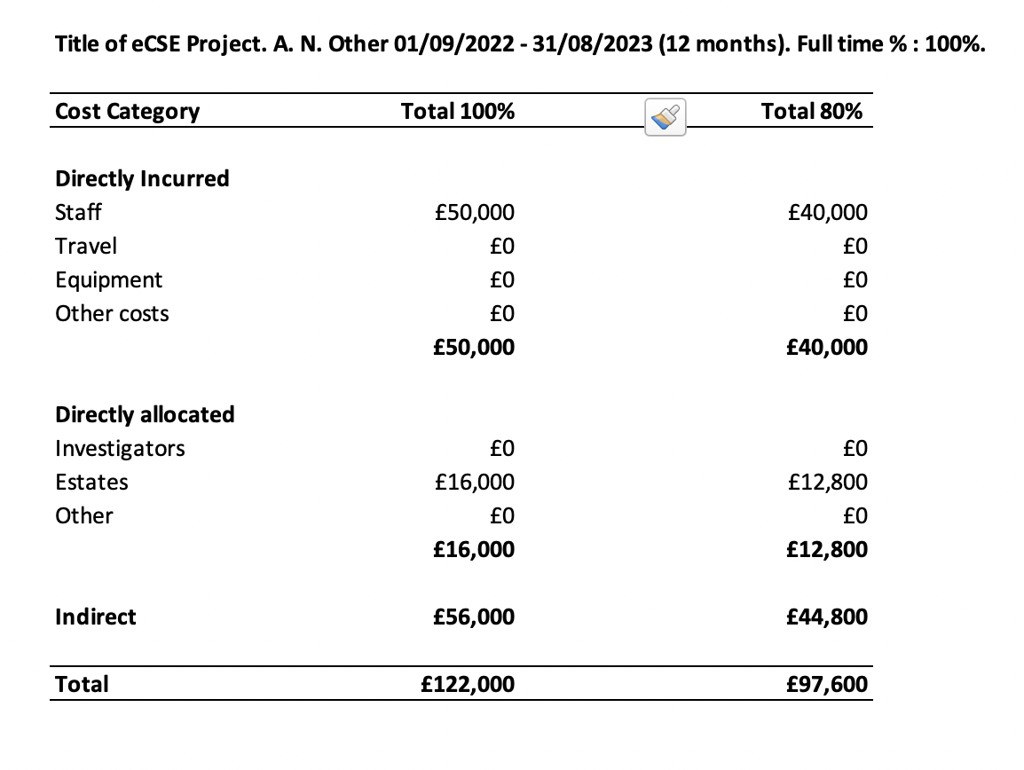
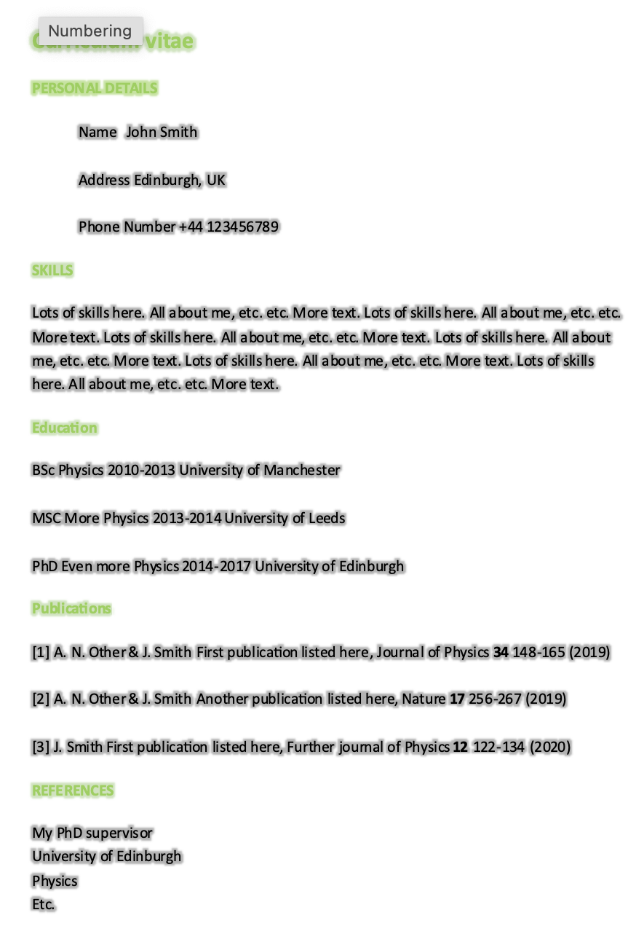

Documents required
SAFE form
Proposal Document (required)
Costing document(s)
(required for each RSE)
CV (required for each RSE)
Letter of Support (optional)

Slide 14
Beginning an eCSE Application
Visit call page https://www.archer2.ac.uk/ecse/calls/
links to templates, guidance and terms
Start in the SAFE
https://safe.epcc.ed.ac.uk/
Enter Project Title, subject area and research area (remit)

Slide 15

GPU eCSE Calls on-line
If your proposal is selected for funding, you will be provided with an award letter and will be asked to agree to the eCSE Terms.
Please view the Terms in advance of submitting the proposal.

Slide 16
Proposal templates
The eCSE form has an online form to which documents should be attached before submission
MS Word templates available for proposal document
Proposal template
Project Title
PI Name and Institution
Description of code(s)
Project Objectives and success metrics
Project Overview, Technical Information and Workplan
Sustainability, maintenance, validation and availability of code(s)
Impact and Benefits

Slide 17
Description of codes(s)
Up to 2 pages
Tell us about the code! What is it for? what does it do? Who uses it?
How big is it? How is it structured (how complex)?
What language(s) does it use and any dependencies (libs, compilers, other software)?
What is the code’s status in terms of usage and performance?
Performance data may include scaling (if multi-GPU), profiling data, or comparison of GPU code with CPU code
Can include links but include summary in text

Slide 18
Project Objectives and success metrics
Up to 1 page
Number of objectives and associated success metrics expected
1-2 objectives for a proposal requesting <6 PMs of effort
5-6 objectives for a proposal with the maximum requested effort of 36 PMs
This is just a guide!
Expect each objective to have an associated success metric
Success metrics should be specific and measurable. E.g. the following sounds reasonable
“We will significantly improve the scaling of the GPU code compared with the existing code on a set of benchmark codes”
but isn’t really specific or measurable
Which codes? How many? What improvements are expected? For what problem sizes?

Slide 19
Project Overview, Technical Information and Workplan
Up to 2 pages
This is where you describe what you will do in the project
Describe from a technical viewpoint
But should be understandable to someone who doesn’t know the code specifically
Should include
associated timescales
Gantt chart (or equivalent) of the workplan with milestones and effort broken down by RSE (if > 1 RSE)
Risk – with likelihood and possible mitigation

Slide 20
Sustainability, maintenance, validation and availability of code(s)
Up to 1 page
Should describe how code(s) will be
made available to users
maintained
State what coding standards will be used, etc.
Should include any information on the licensing model
Describe both for users
wishing to run the code(s) and
wanting access to the underlying source code(s)

Slide 21
Impacts and Benefits
Up to 1 page
Describe potential impact of the science enabled by the project
How will impact be achieved?
Some impacts may be realised after the end of the project
Consider
both the computational and scientific benefits
who will benefit

Slide 22
Applying for an eCSE Project
Final deadline for full proposals submitted to the SAFE is then 16:00 19th March 2024
Late proposals will not be considered!
Previous eCSE calls had a separate technical evaluation, this is now part of the main proposal
Any project team members must be invited to a proposal and have accepted the invitation via the SAFE before final submission
Otherwise they will not be considered part of the team
Allowable roles are PI, Co-I, technical staff, Contact, Member
Technical staff add their own CVs
All other team members must provide track record and describe what they will bring to project
When inviting people, please use the email address they use in the SAFE
Note that you cannot submit without technical staff (or unnamed staff selected)

Slide 23
Costings
Please provide 100% FEC value for each member of technical staff
We pay 80% FEC for funded proposal
Funding only includes technical staff
Include direct and indirect costs but not additional costs (e.g. PI/Co-I costs)
Provide breakdown of costs as a PDF (Worktribe of equivalent)
No need to provide costings for ARCHER2 CSE staff
Travel is given separately from above
Funds are limited – see guidance
Can include project members traveling with UK to meet each other
Additionally each RSE can be funded to attend one national/international conference
If your institution does not use FEC please contact us in advance
We pay the PI’s institution via invoice
Any payment to third parties is paid via the PI’s institution
Recommend you use named staff where possible
Ability of technical staff to complete the work is assessed
Considered together with PI/Co-I expertise

Slide 24
eCSE Costing document
Example costing for 12-month project
Made up numbers
This is not a real document!
Shows the information we need
✘
Enter 100% total costing in proposal form
Form then calculates 80%
✘
✓

Slide 25
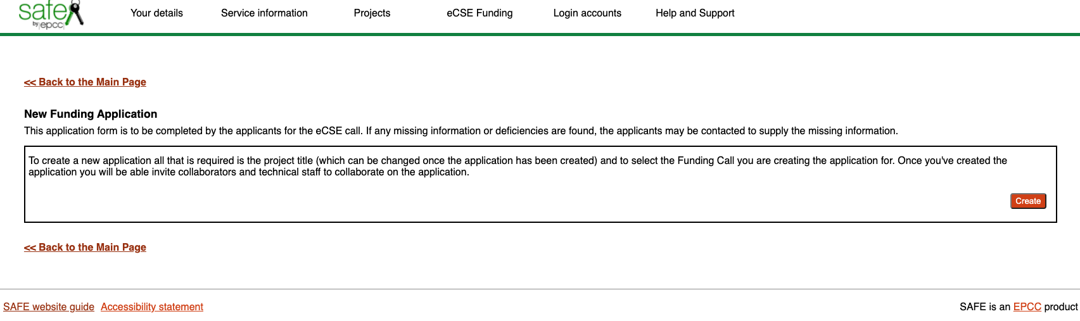

eCSE – Submitting a proposal
Notes:
https://youtu.be/3uYc8G4d9DM

Slide 26
eCSE – things to watch out for
Doesn’t look technically feasible (either within the timescale or at all)
Poor estimate of effort - may be over or under ambitious for effort requested
Sometimes just missing the basic “why”, “how”
Proposal may technically desirable but missing the “why”
E.g. project has clear plan for reducing time taken for a code by large percentage...
…but why does that matter? Who uses code? For what? Why is the code important?
Staffing not suitable
Missing needed expertise with code or GPU skills – or a plan to obtain these skills
Missing suitable analysis of risk
E.g. how will WP4 work if WP3 isn’t successful?
Success metrics not quantified
Letters of support not specific
Do proof-read (or get a colleague to)!
Sometimes nothing specifically wrong but details just not well enough explained

Slide 27
Summary
The first GPU eCSE call is open – see time timetable for future calls
Expect further calls over the year
Final deadline for full proposals: 16:00 19th March 2024 -> SAFE
Early Career Observers call open alongside (deadline 16:00 27th Feb 2024) -> ARCHER2 service desk
Details of calls
https://www.archer2.ac.uk/ecse/
Any questions please ask here or via the ARCHER2 service desk support@archer2.ac.uk

Slide 28
Any Questions?
www.archer2.ac.uk

